Slide 1
Ch 5: Analog Transmission

Slide 2
Introduction
Converting digital signal to a bandpass analog signal is called digital-to-analog conversion
Converting a low-pass analog signal to a bandpass analog signal is traditionally called analog-to-analog conversion
Types
  Digital-to-analog conversion
  Analog-to-analog conversion

Slide 3
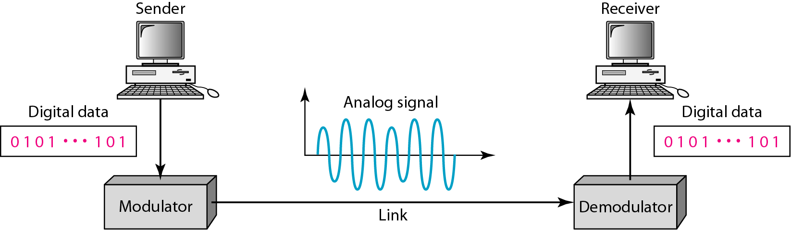
Digital-to-Analog Conversion
Process of changing one of the characteristics of an analog signal based on information in digital data

Slide 4
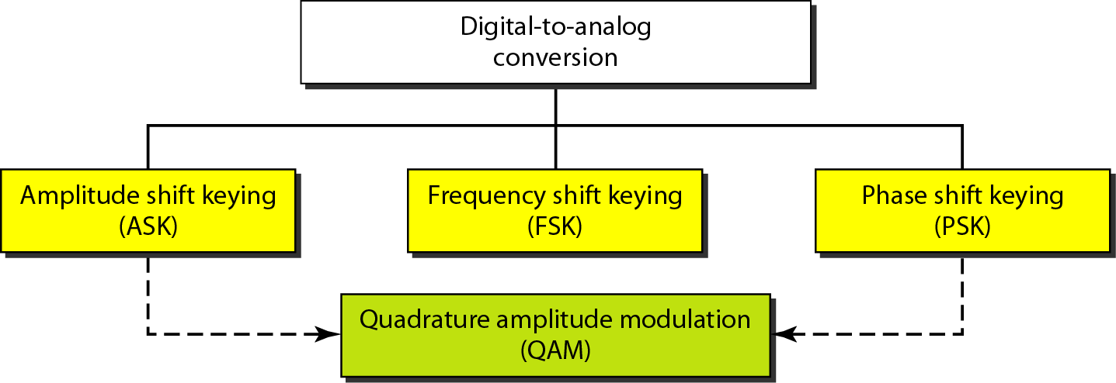
Types of Digital-to-Analog Conversion
If we change the amplitude, phase or frequency of a sine wave, a different version of the wave can be created.

Slide 5
Digital-to-Analog Conversion: Aspects
Data Element versus Signal Element
  Smallest piece of information to be exchanged is data element
  Smallest unit of a signal that is constant is signal element
Data Rate versus Signal Rate
  S = N x 1/r
  N is data rate (bps) and r is the number of data elements carried in one signal element
  r = log₂ L
  L is the number of different signal elements
Bit rate, N, is the number of bits per second (bps). Baud rate is the number of signal
elements per second (bauds).
In the analog transmission of digital data, the signal or baud rate is less than
or equal to the bit rate.

Slide 6
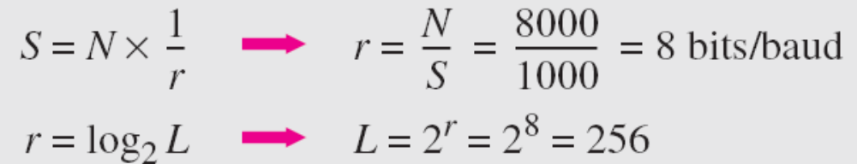
An analog signal carries 4 bits per signal element. If 1000 signal elements are sent per second, find the bit rate.
In this case, r = 4, S = 1000, and N is unknown. We can find the value of N from
An analog signal has a bit rate of 8000 bps and a baud rate of 1000 baud. How many data elements are carried by each signal element? How many signal elements do we need?
In this example, S = 1000, N = 8000, and r and L are unknown. We find first the value of r and then the value of L.

Slide 7
Digital-to-Analog Conversion: Aspects
Bandwidth
  Required bandwidth is proportional to the signal rate except for FSK in which, the difference between the carrier signals needs to be added
Carrier Signal
  Sending device produces a high-frequency signal that acts as a base for the information signal
  Receiving device is tuned to the frequency of the carrier signal that it expects from the sender
  This base signal is called carrier signal or carrier frequency
  Digital information then changes the carrier signal by modifying one or more of its characteristics (amplitude, frequency or phase)
    Called modulation

Slide 8
Digital-to-analog conversion: Amplitude Shift Keying (ASK)
Amplitude is varied to create signal elements
Binary ASK (BASK) or ON-OFF Keying (OOK)
  ASK is normally implemented using only two levels
  The peak amplitude of one signal level is 0; the other is the same as the amplitude of the carrier frequency

Slide 9
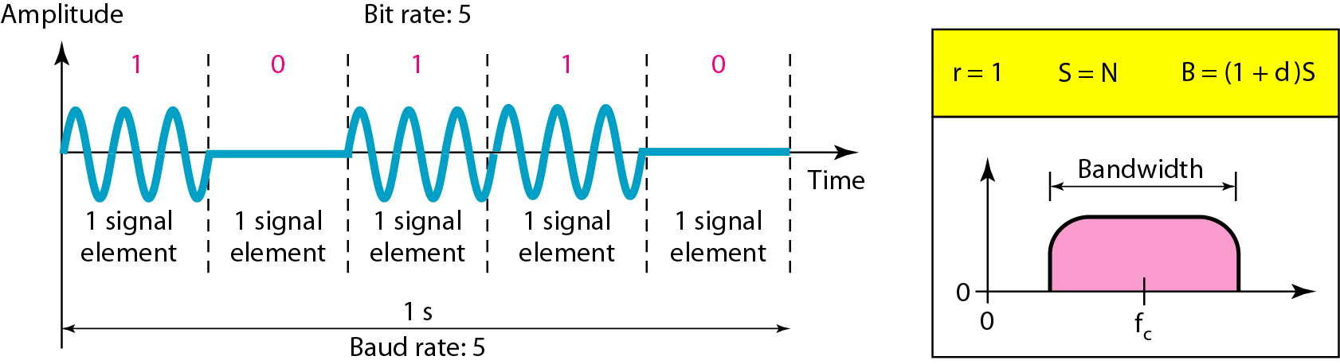
Binary Amplitude Shift Keying
Bandwidth
  In BASK, the carrier is either on (1) or off (0), meaning the modulated signal switches between the carrier and zero amplitude. This sudden switching introduces sharp transitions in the time domain, which translates to higher-frequency components in the frequency domain — increasing the bandwidth.
  Process of modulation produces a nonperiodic composite signal
  Bandwidth is proportional to signal rate (baud rate)
  Normally there is another factor involved, called d, which depends on modulation
  Value of d is between 0 and 1
  Middle of the bandwidth is where f_{c}, the carrier frequency is located
  If we have bandpass channel, we can choose our fc so that modulated signal occupies the bandwidth
Bandwidth B = (1 + d) X S
B_{min} = S and B_{max} = 2S

Slide 10
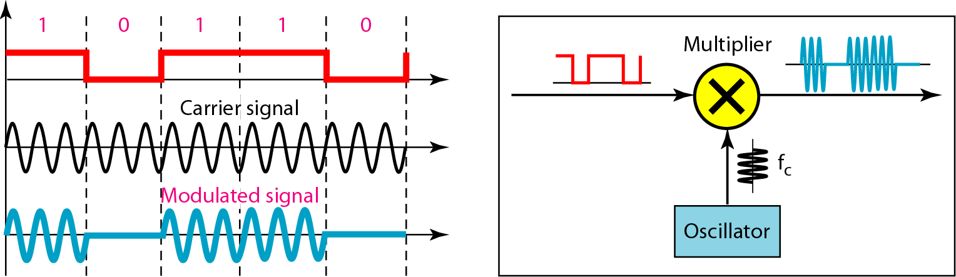
Implementation of Binary ASK
Implementation
  Multiply the input NRZ digital signal by the carrier signal coming from an oscillator
  when amplitude of NRZ signal is 1, amplitude of carrier signal is held
  when amplitude of NRZ signal is 0, amplitude of carrier frequency is zero
We can use 4, 8, 16 or more different amplitudes for signal and modulate the data using 2, 3, 4 or more bits at a time. This is Multilevel ASK. It is not implemented using pure ASK, it is implemented using Quadrature Amplitude Modulation (QAM).

Slide 11
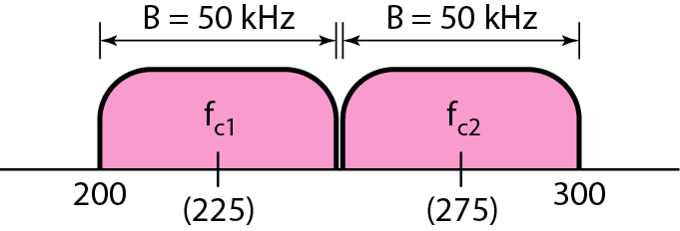
We have an available bandwidth of 100 kHz which spans from 200 to 300 kHz. What are the carrier frequency and the bit rate if we modulated our data by using ASK with d = 1?
The middle of the bandwidth is located at 250 kHz. This means that our carrier frequency can be at f_{c} = 250 kHz. We can use the formula for bandwidth to find the bit rate (with d = 1 and r = 1).
In data communications, we normally use full-duplex links with communication in both directions. We need to divide the bandwidth into two with two carrier frequencies, as shown in Figure. The figure shows the positions of two carrier frequencies and the bandwidths. The available bandwidth for each direction is now 50 kHz, which leaves us with a data rate of 25 kbps in each direction.

Slide 12
Digital-to-Analog Conversion: Frequency Shift Keying (FSK)
Frequency of the carrier signal is varied to represent data
Frequency of the modulated signal is constant for the duration of one signal element, but changes for the next signal element if the data element changes
Both peak amplitude and phase remain constant for all signal elements
The digital data stream changes the frequency of the carrier signal, f_{c}
a “1” could be represented by f₁=f_{c} +Δ_{f}, and a “0” could be represented by f₂=f_{c}-Δ_{f}

Slide 13
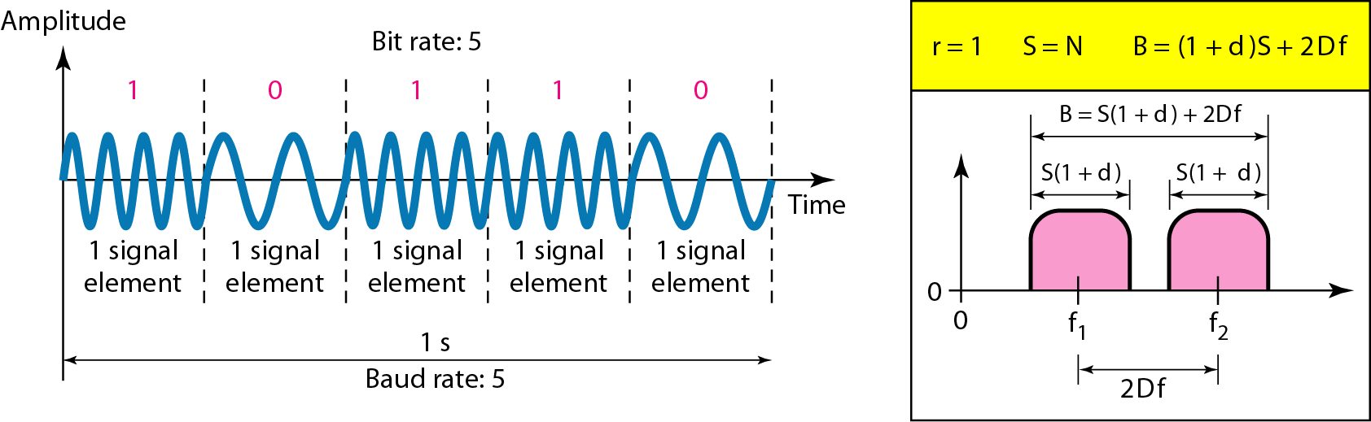
Binary Phase Shift Keying (BFSK)
Middle of one bandwidth is f₁ and middle of another bandwidth is f₂
Difference between two frequencies is 2Δ_{f}
Bandwidth is B = (1 + d) * S + 2 Δ_{f}

Slide 14
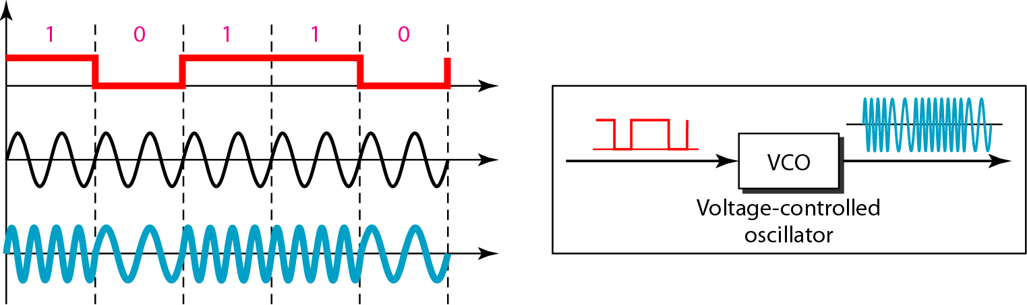
We have an available bandwidth of 100 kHz which spans from 200 to 300 kHz. What should be the carrier frequency and the bit rate if we modulated our data by using FSK with d = 1?
The midpoint of the band is at 250 kHz. We choose 2Δf to be 50 kHz; this means
Implementation of BFSK

Slide 15
Implementation
Noncoherent implementation
    When we change from one frequency to the other, we do not adhere to the current phase of the signal
Coherent implementation
    The switch from one frequency signal to the other only occurs at the same phase in the signal
    Implemented using one voltage-controlled-oscillator (VCO) that changes its frequency according to input voltage
We can use more than 2 frequencies. Use f₁, f₂, f₃ and f₄ to send 2 bits at a time; Use f₁, f₂, f₃, f₄, f₅, f₆, f₇ and f₈ to send 3 bits at a time and so on. Frequencies need to be 2Δ_{f} apart.

Slide 16
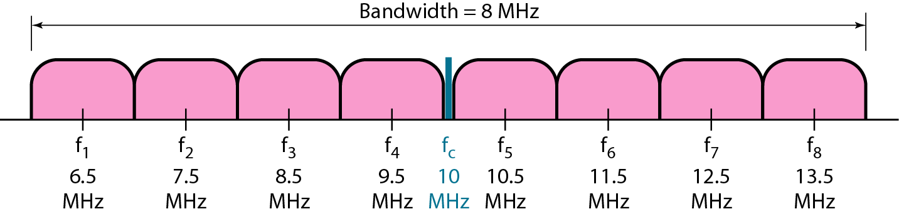
We need to send data 3 bits at a time at a bit rate of 3 Mbps. The carrier frequency is 10 MHz. Calculate the number of levels (different frequencies), the baud rate, and the bandwidth.
We can have L = 2³ = 8. The baud rate is S = 3 Mbps/3 = 1 Mbaud. This means that the carrier frequencies must be 1 MHz apart (2Δf = 1 MHz). The bandwidth is B = 8 × 1M = 8M. Figure shows the allocation of frequencies and bandwidth

Slide 17
Digital-to-analog Conversion: Phase Shift Keying (PSK)
Phase of the carrier is varied to represent two or more different signal elements
Both peak amplitude and frequency remain constant as the phase changes
PSK is more common than ASK or FSK
QAM that combines ASK and PSK is dominant method of digital-to-analog modulation
Binary Phase Shift Keying (BPSK)
  We have only two signal elements-one with a phase 0⁰ and other with phase of 180⁰

Slide 18
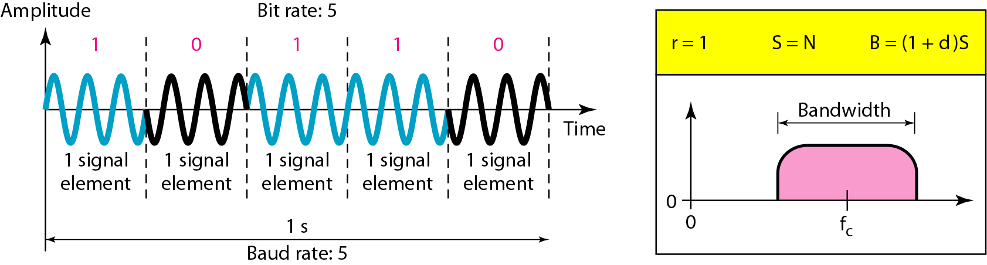
Binary Phase Shift Keying (BPSK)
Less susceptible to noise when compared to ASK
  Criterion for bit detection is the phase of the signal as noise can change the amplitude, but not phase
PSK is superior to FSK as we do not require two carrier signals
It needs more sophisticated hardware
Bandwidth
  Bandwidth is same as that for binary ASK, but less than for BFSK
  No bandwidth is wasted for separating two carrier signals

Slide 19
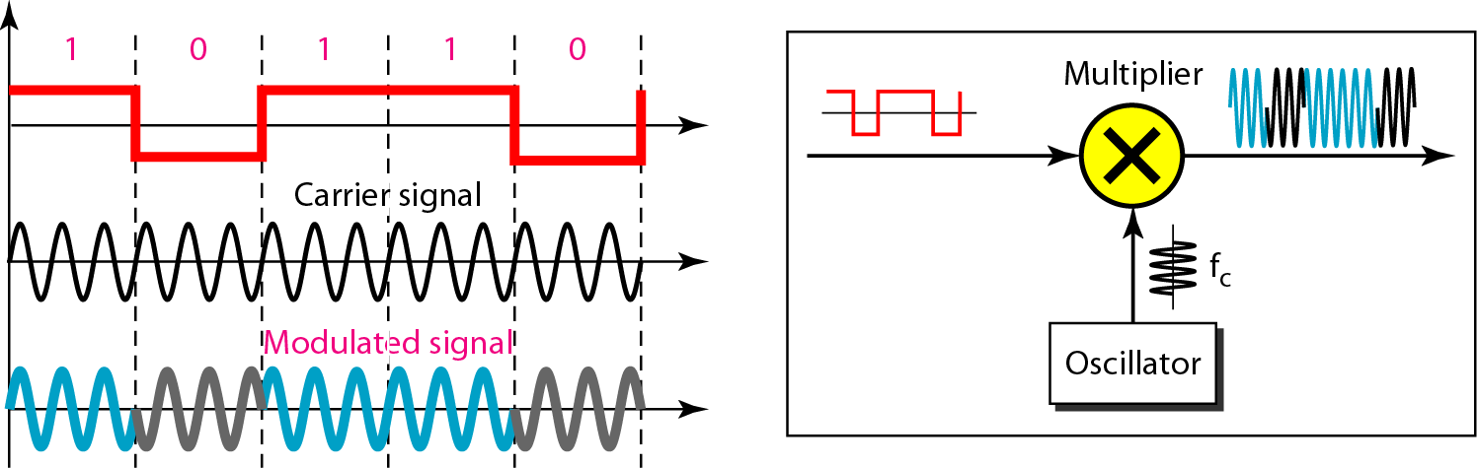
Implementation of BPSK
Polar NRZ signal is multiplied by the carrier frequency
The 1 bit (positive voltage) is represented by a phase starting at 0⁰
The 0 bit (negative voltage) is represented by a phase starting at 180⁰

Slide 20
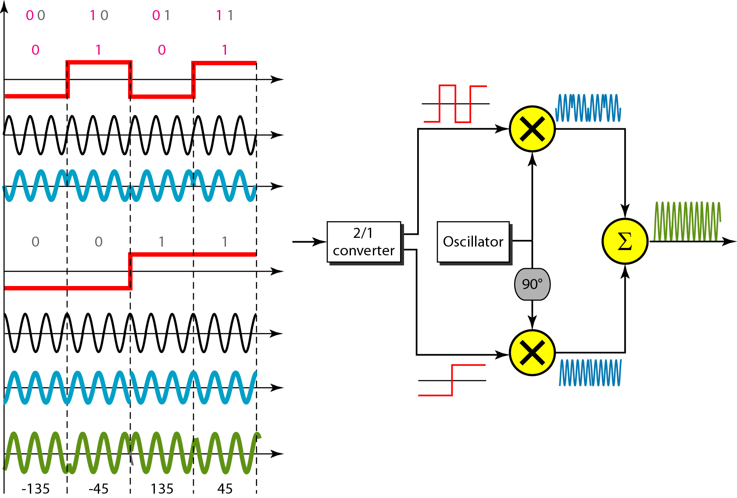
QPSK and its implementation

Slide 21
To increase the bit rate, we can code 2 or more bits onto one signal element.
In QPSK, we parallelize the bit stream so that every two incoming bits are split up and PSK a carrier frequency. One carrier frequency is phase shifted 90º from the other - in quadrature.
The two PSKed signals are then added to produce one of 4 signal elements. L = 4 here.
Find the bandwidth for a signal transmitting at 12 Mbps for QPSK. The value of d = 0.
For QPSK, 2 bits is carried by one signal element. This means that r = 2. So the signal rate (baud rate) is S = N × (1/r) = 6 Mbaud. With a value of d = 0, we have B = S = 6 MHz.

Slide 22
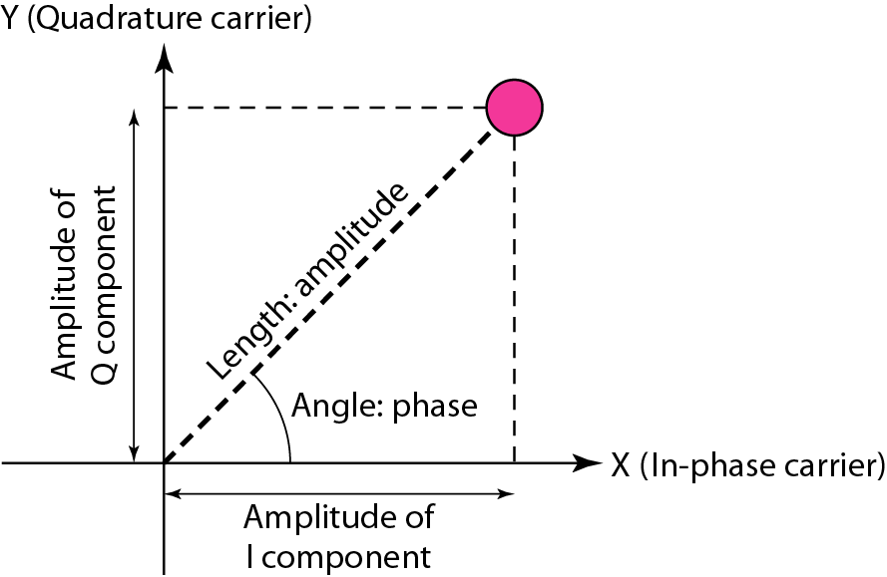
Concept of a Constellation Diagram
A constellation diagram helps us to define the amplitude and phase of a signal when we are using two carriers, one in quadrature of the other
The X-axis represents the in-phase carrier and the Y-axis represents quadrature carrier
Useful when we are dealing with multilevel ASK, PSK or QAM

Slide 23
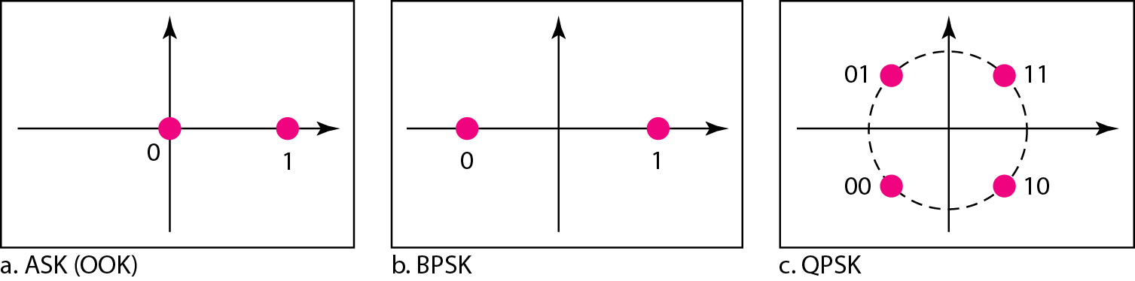
Show the constellation diagrams for an ASK (OOK), BPSK, and QPSK signals.
In ASK, we use only an in-phase carrier; so, the two points should be on the X axis
Binary 0 has the amplitude of 0 V; binary 1 has an amplitude of 1 V
The points are located at the origin and at 1 unit
BPSK uses only an in-phase carrier; however we use a polar NRZ signal for modulation
Creates two types of signal elements, one with amplitude 1 and the other with amplitude -1
BPSK creates two different signal elements, one with amplitude 1 V and in phase and the other with amplitude 1 V and 180⁰ out of phase
QPSK uses two carriers, one in-phase and the other quadrature
Point representing 11 is made of two combined signal elements, both with an amplitude of 1 V
One element is represented by an in-phase carrier, the other by a quadrature carrier

Slide 24
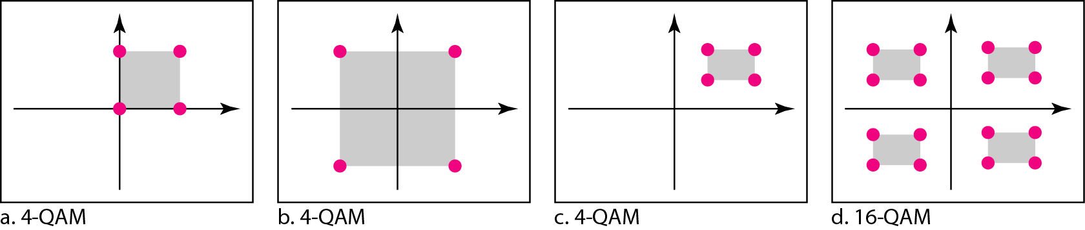
Constellation Diagrams for some QAMs
Quadrature Amplitude Modulation is a combination of ASK and PSK

Slide 25
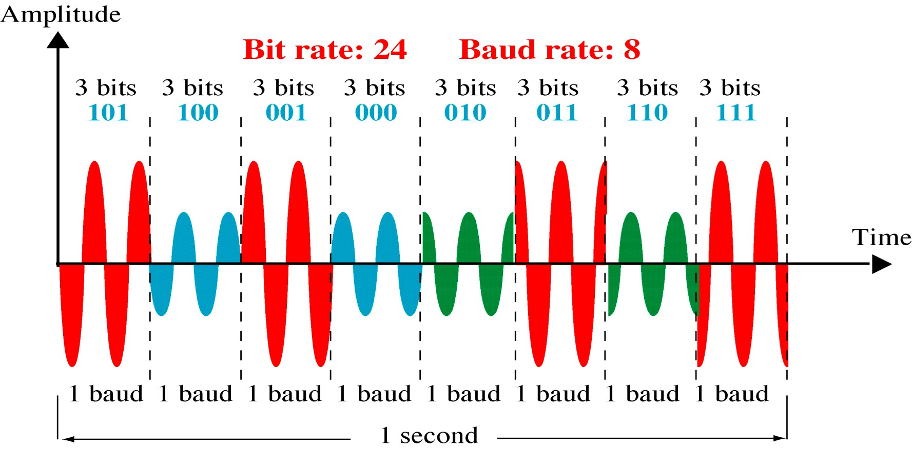
8-QAM

Slide 26
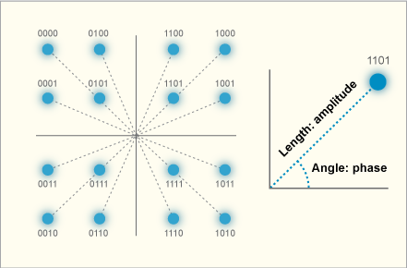
16-QAM Constellations

Slide 27
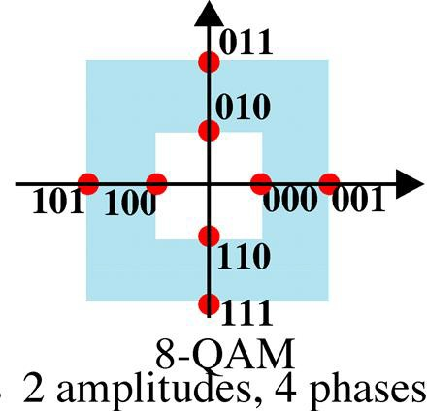
8-QAM Constellations

Slide 28
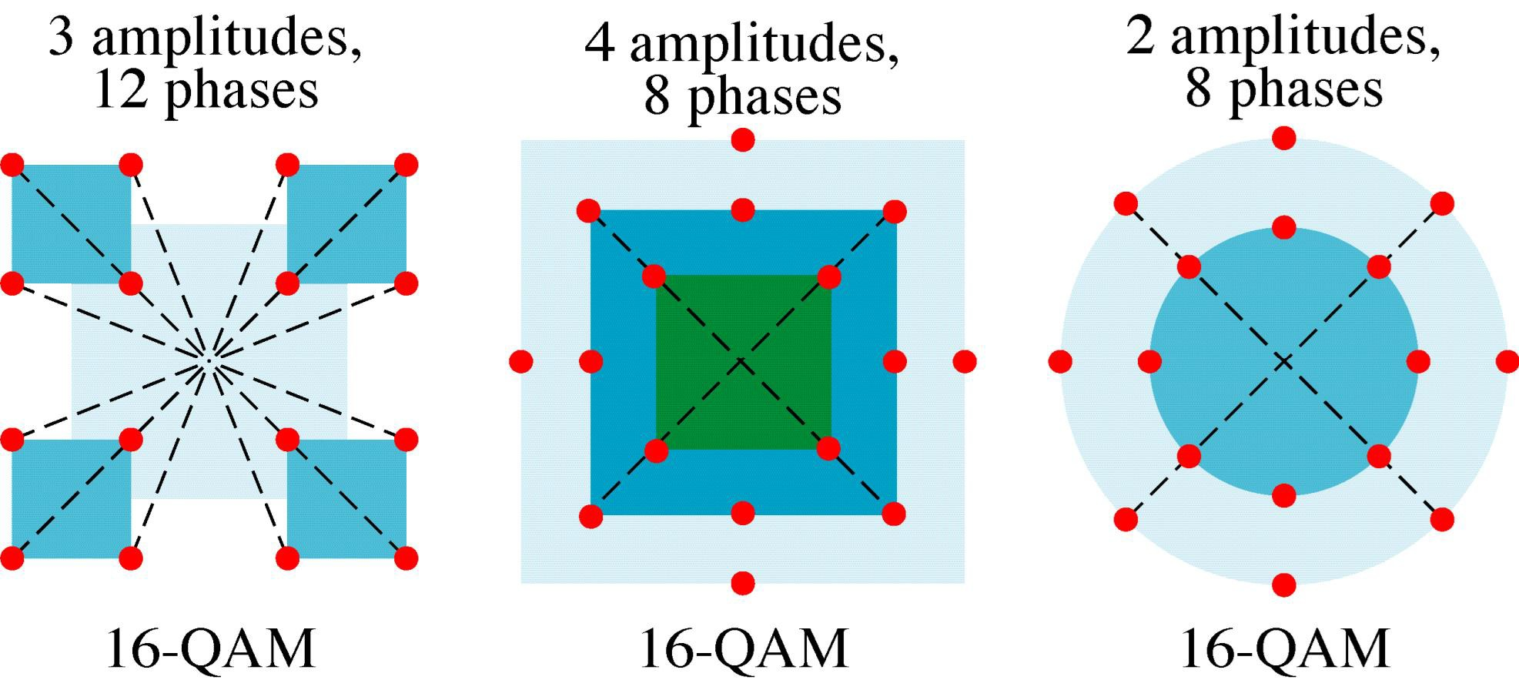
16-QAM Constellations

Slide 29
Analog-to-Analog Conversion
Also called Analog Modulation
  Representation of analog information by an analog signal
Reason
  Modulation is needed if the medium is bandpass in nature or if only a bandpass channel is available
  Eg. Radio
  Government assigns a narrow bandwidth to each radio station
  The analog signal produced by each station is a low-pass signal, all in the same range
  To be able to listen to different stations, low pass signals need to be shifted, each to a different range

Slide 30
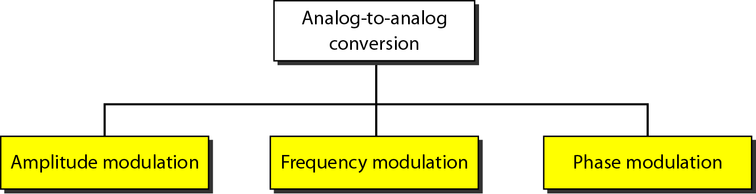
Types of analog-to-analog modulation

Slide 31
Analog-to-Analog Conversion: Amplitude Modulation (AM)
A carrier signal is modulated only in amplitude value
The modulating signal is the envelope of the carrier
Frequency and phase of the carrier remain the same; only the amplitude changes to follow variations in the information
The required bandwidth is 2B, where B is the bandwidth of the modulating signal
Since on both sides of the carrier freq. f_{c}, the spectrum is identical, we can discard one half, thus requiring a smaller bandwidth for transmission.

Slide 32
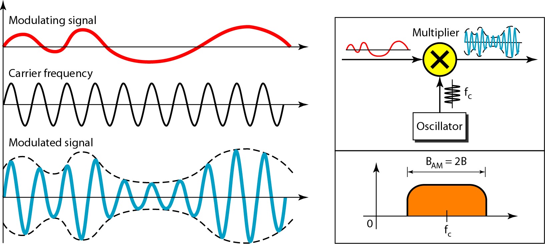
Amplitude Modulation
The total bandwidth required for AM can be determined from the bandwidth of the audio
signal: B_{AM} = 2B

Slide 33
Analog-to-Analog Conversion: Amplitude Modulation (AM)
Assume the modulating signal is m(t) = A_{m} * cos(2πf_{m}t) and carrier signal is c(t)= A_{c} * cos(2πf_{c}t)
Modulation index m = A_{m} / A_{c}
The value of m decides the level of modulation.

Slide 34
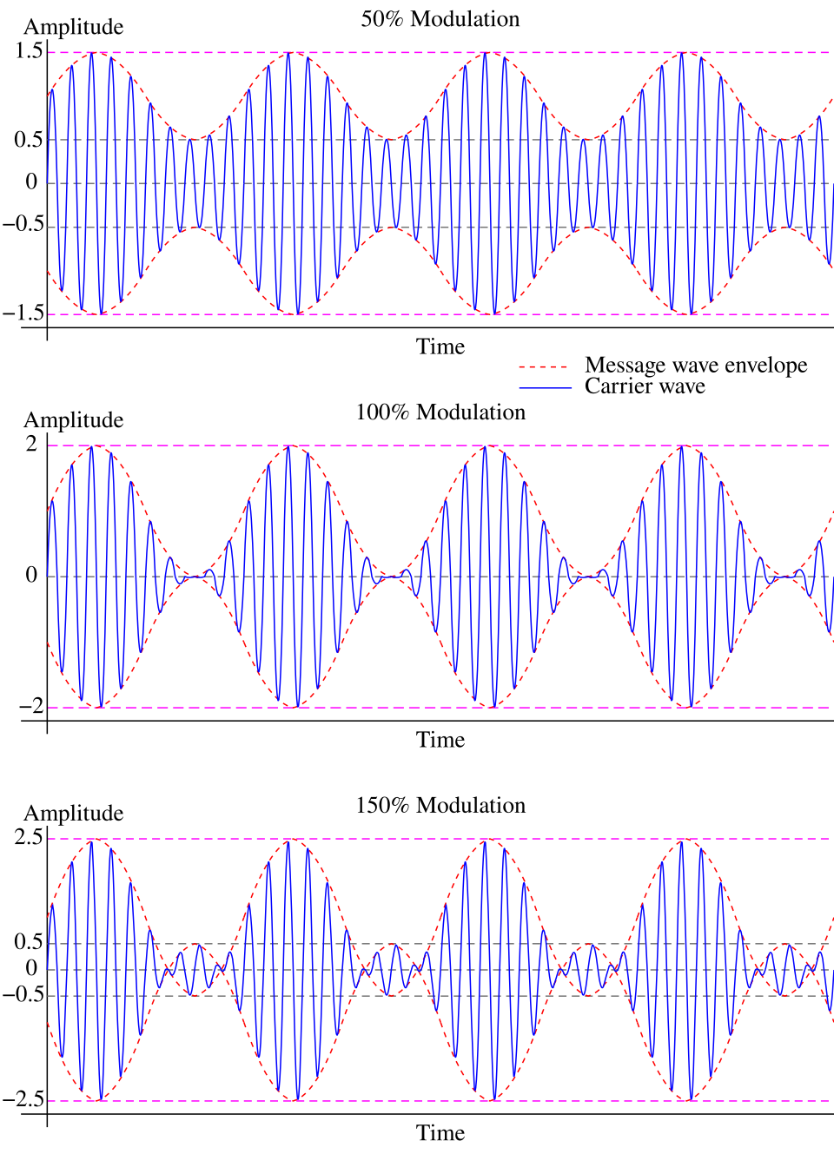
Amplitude Modulation (AM)
Type | Condition | Envelope at Minimum | Distortion | Recovery Method
Under Modulation | Am​<Ac​ (m<1) | Never reaches zero | None | Simple Envelope Detector
Ideal Modulation | Am​=Ac​ (m=1) | Exactly touches zero | None | Simple Envelope Detector
Over Modulation | Am​>Ac​ (m>1) | Crosses zero (Phase Reversal) | Severe (Clipping) | Synchronous Detector only

Slide 35
Analog-to-Analog Conversion: Amplitude Modulation (AM)
The fundamental definition of Amplitude Modulation is that the amplitude of the carrier signal is varied in direct proportion to the instantaneous amplitude of the modulating signal.
The instantaneous amplitude of the modulated wave, let's call it A(t), becomes the sum of the unmodulated carrier amplitude and the message signal: A(t) = A_{c} + m(t) = A_{c} + A_{m} cos(2 π f_{m} t)
The carrier signal with time varying amplitude c(t)= A(t) cos(2πf_{c}t)
=[A_{c} + A_{m} cos(2πf_{m}t)] cos(2πf_{c}t)
=[A_{c} + m A_{c} cos(2πf_{m}t)] cos(2πf_{c}t)
= A_{c}[1+ m cos(2πf_{m}t)] cos(2πf_{c}t)
= A_{c} cos(2πf_{c}t) + A_{c} m cos(2πf_{m}t) cos(2πf_{c}t)
= A_{c} cos(2πf_{c}t) + A_{c} m/2 cos(2π(f_{c} +f_{m})t) + A_{c} m/2 cos(2π(f_{c}-f_{m})t)

Slide 36
Analog-to-Analog Conversion: Amplitude Modulation (AM)
c(t) = A_{c} cos(2πf_{c}t) + A_{c} m/2 cos(2π(f_{c} +f_{m})t) + A_{c} m/2 cos(2π(f_{c}-f_{m})t)
The upper sideband sits on frequency f_{c} +f_{m} and the lower sideband sits on f_{c} –f_{m}
So the bandwidth is f_{c} +f_{m} – (f_{c} -f_{m}) = 2 f_{m}

Slide 37
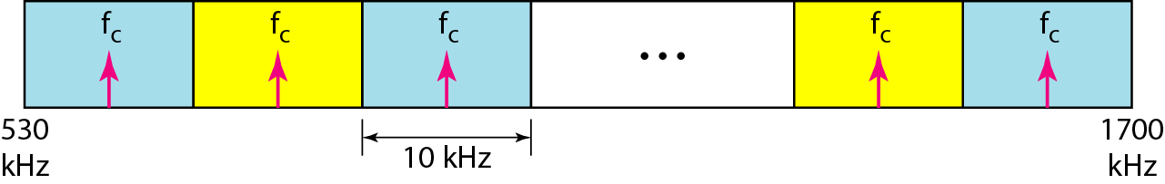
AM Radio Band Allocation

Slide 38
Analog-to-Analog Conversion: Frequency Modulation (FM)
The modulating signal changes the frequency f_{c} of the carrier signal
The bandwidth for FM is high
It is approximately 10x the signal frequency
Peak amplitude and phase of the carrier signal remain constant, but as the amplitude of the information changes, the frequency of the carrier changes correspondingly

Slide 39
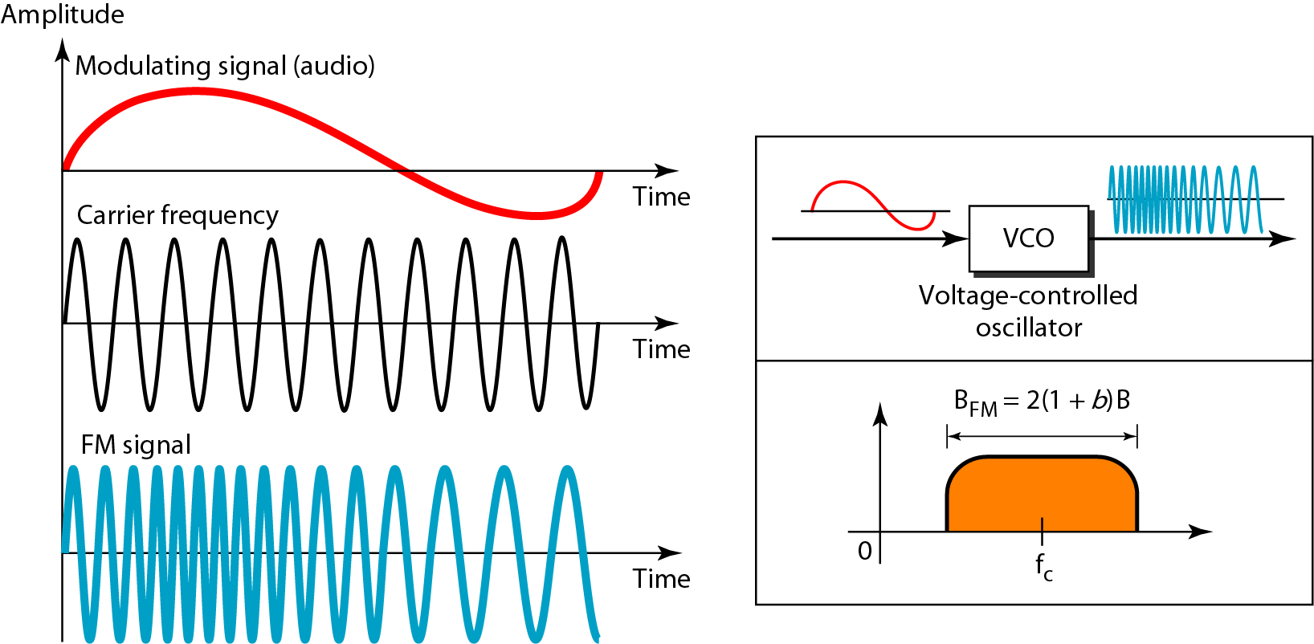
Frequency Modulation
The total bandwidth required for FM can be determined from the bandwidth
of the audio signal: B_{FM} = 2(1 + β)B. Here β is usually 4

Slide 40

Frequency Modulation (FM)
Assume the message signal is
Carrier signal is
In FM, the frequency of the carrier is not constant.
Define the instantaneous frequency, f_{i}(t), as the base carrier frequency plus a shift that is directly proportional to the message signal: where k_{f} is frequency sensitivity constant of the modulator, measured in Hertz per Volt (Hz/V). It determines how much the frequency shifts for every 1-volt change in the message signal.

Slide 41





Frequency Modulation (FM)
In general, any sinusoidal signal is , where θ_{i}(t) is the total instantaneous phase angle.
A fundamental rule of physics and signals is that frequency is the rate of change of phase.
To find the total phase angle θ_{i}(t), we must integrate the instantaneous angular frequency ω_{i}(t) = 2πf_{i}(t) with respect to time:

Slide 42

Frequency Modulation (FM)
Maximum Frequency Deviation (Δf) is the maximum shift away from the center carrier frequency( )
FM Modulation Index (β) is the ratio of the maximum frequency deviation to the message frequency ( )
The general carrier equation becomes,
The message signal’s contribution is embedded strictly inside the angle of the cosine function, making the amplitude A_{c} perfectly constant.
Theoretically the bandwidth of FM is infinite, but practically using Carson’s rule, the BW is given as

Slide 43
Frequency Modulation (FM)
Narrowband FM (NBFM): Occurs when the modulation index is very small (β << 1).
  The frequency deviation (Δf) is extremely small compared to f_{m}.
  Carson's rule simplifies to: BW ≈2f_{m}.
  Use Case: Walkie-talkies, marine radios, and amateur radio. It uses the same bandwidth as AM but offers better noise immunity.
Wideband FM (WBFM): Occurs when the modulation index is large (β >>1)
  The frequency deviation (Δf) dominates the equation.
  Carson's rule simplifies to: BW ≈ 2 Δf.
  Use Case: Commercial FM radio and television audio. It consumes a lot of bandwidth but provides excellent, high-fidelity audio quality.

Slide 44
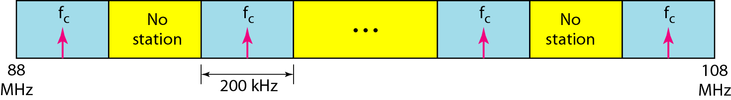
FM Band Allocation

Slide 45


Analog-to-Analog Conversion:
Phase Modulation (PM)
The modulating signal only changes the phase of the carrier signal
When the phase of the carrier changes, the frequency also changes. This happens because frequency is the rate of change of phase with respect to time.
Carrier signal can be written as
Instantaneous phase
Where k_{p} phase sensitivity constant of the modulator. It is measured in radians per volt (rad/V).
Maximum Phase Deviation (ΔФ) is the maximum possible phase shift away from the unmodulated carrier's phase. It depends entirely on the message amplitude and the sensitivity constant.
PM Modulation Index
Unlike FM, where the modulation index β is divided by f_{m}, the PM modulation index β_{p} is completely independent of the message frequency.
Final PM Equation

Slide 46
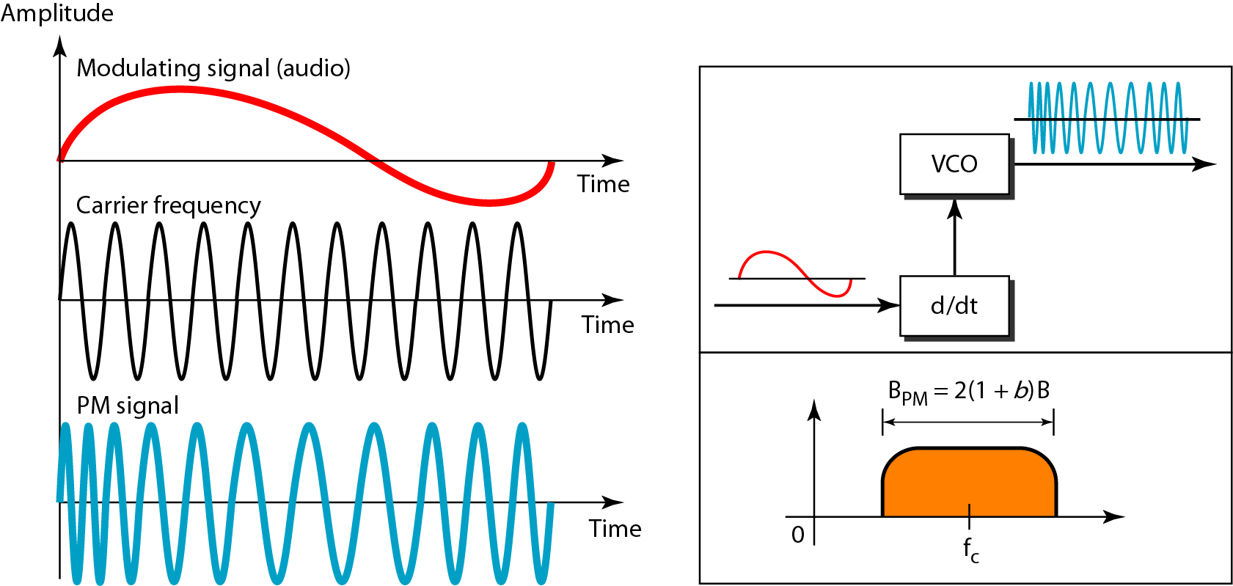
Phase Modulation
The total bandwidth required for PM can be determined from the bandwidth
and maximum amplitude of the modulating signal: B_{PM} = 2(1 + β)B.
Here β = 2 most often

Slide 47
Thank you!!!

Slide 48
